Slide 1
INFORMATION SYSTEMS SECURITY, CONTROL AND AUDIT
Information Systems Security
MALICIOUS CODE AND ACTIVITY
Week 10

Slide 2
Main Types of Malware
Evidence of Virus Code Activities
Threats to Business Organizations
Anatomy of an Attack
Attack Prevention Tools and Techniques
Incident Detection Tools and Techniques

Slide 3
Malicious Code
Malicious Code attacks all three information security properties:
Availability
Integrity
Confidentiality

Slide 4
Malicious Code
Malicious Code attacks all three information security properties:
Availability – Malware can erase or overwrite files or inflict considerable damage to storage media
Integrity – Malware can modify database records either immediately or over a period of time.
Confidentiality – Malware can disclose private information.

Slide 5
Main Types of Malicious Code and Activity
1) Virus – is an executable program that attaches to, or infects, other executable programs. It then replicates to infect yet more programs (see flowchart next page).

Slide 6
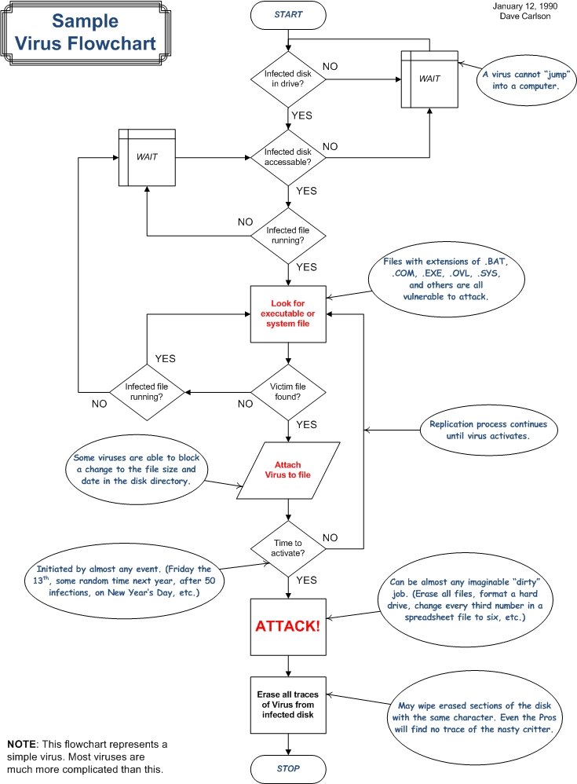

Slide 7
Main Types of Viruses
There are three main types of viruses:
System Infectors – target computer hardware and software startup functions
File Infectors – Attack and modify executable files
Data Infectors – Attack document files containing embedded macro programming capabilities.

Slide 8
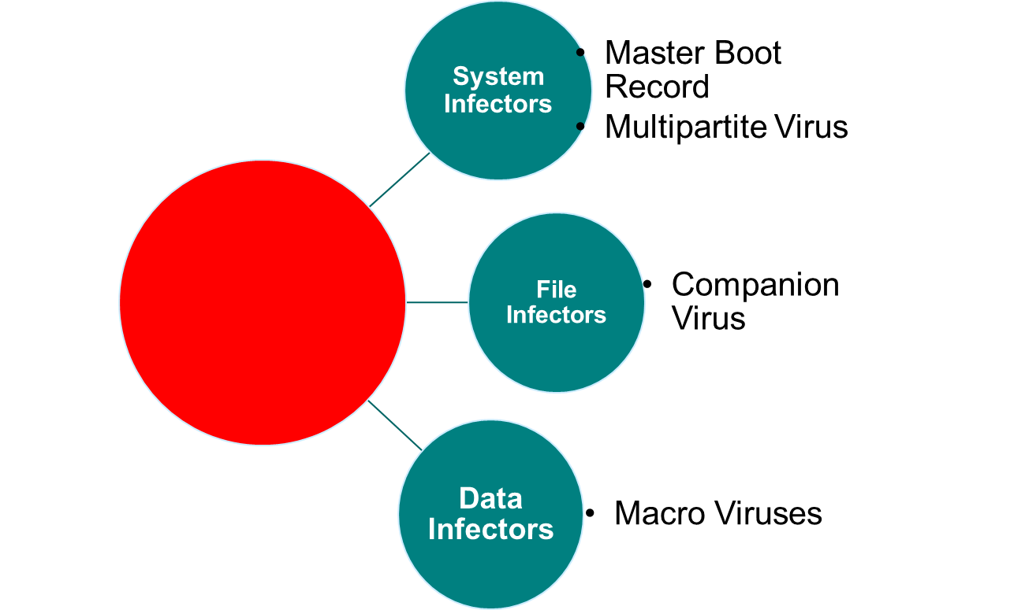
Main Types of Viruses
VIRUSES

Slide 9
Polymorphic Viruses
These types of viruses include a separate encryption engine that stores the virus body in encrypted format while duplicating the main body of the virus.
This virus exposes only the decryption routine for possible detection.

Slide 10
Stealth Viruses
Use a number of techniques to conceal themselves from users and from detection software.
They can have size stealth, read stealth or both.
Size stealth hides the fact that an infected file is bigger than it used to be. The virus intercepts system requests for file information & subtracts its size from the reply before pasting it back to the requesting process.

Slide 11
Slow Virus
Resides in the computer’s memory where antivirus cannot detect it.
Retro Virus
Attack countermeasures such as antivirus signature files or integrity databases
Multipartite Virus
Hybrid viruses that have multiple behaviors. They can be file infectors within an application and upon infection they spawn a master boot record infection.

Slide 12

Spam
Spam often contains malicious code.
Spam is unsolicited commercial e-mail.
Electronic spamming is the use of electronic messaging systems to send unsolicited messages (spam), especially advertising, as well as sending messages repeatedly on the same site.

Slide 13
Spam
While the most widely recognized form of spam is e-mail spam, the term is applied to similar abuses in other media: instant messaging spam, Usenet newsgroup spam, Web search engine spam, spam in blogs, wiki spam, online classified ads spam, mobile phone messaging spam, Internet forum spam, junk fax transmissions, social spam, television advertising and file sharing spam.

Slide 14
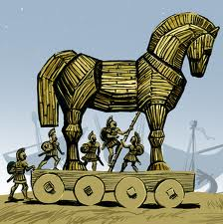
Trojan Horses
A Trojan is any program that masquerades as a useful program while

Slide 15

Logic Bombs
A Logic Bomb is a program that executes a malicious function of some kind when it detects certain conditions.

Slide 16
Main Types of Malicious Code and Activity
1) Virus – is an executable program that attaches to, or infects, other executable programs. It then replicates to infect yet more programs (see flowchart next page).
2) Botnets – Robotically control networks – vulnerable computers are infected and subsequently put under the command of the bot herder/controller.

Slide 17
Main Types of Malicious Code and Activity
3) Denial of Service Attack – The purpose of this attack is to overwhelm a server or network segment to the point it becomes unusable.
4) SYN Flood Attack – An attacker uses IP spoofing to send a large number of packets requesting connections to the victim computer. Victim computer reserves

Slide 18
SYN Flood Attack
A SYN flood is a form of denial-of-service attack in which an attacker sends a succession of SYN requests to a target's system in an attempt to consume enough server resources to make the system unresponsive to legitimate traffic.

Slide 19
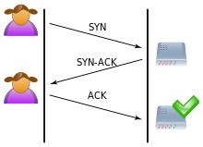
SYN Flood Attack

Slide 20
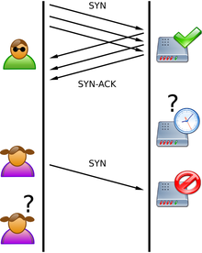
SYN Flood Attack
SYN Flood. The attacker (Mallory) sends several packets but does not send the "ACK" back to the server. The connections are hence half-opened and consuming server resources. Alice, a legitimate user, tries to connect but the server refuses to open a connection resulting in a denial of service.

Slide 21
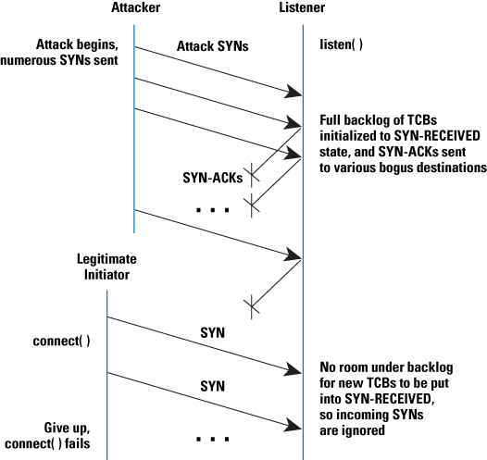
SYN Flood Attack

Slide 22
Main Types of Malicious Code and Activity
5) Smurf Attack – Attacker direct forged ICMP echo request packets to IP broadcast addresses from remote locations to generate denial of service attacks
6) Spyware – Is an unsolicited background process that installs itself on a user’s computer and collects information about user’s browsing habits.

Slide 23
Main Types of Malicious Code and Activity
7) Phishing – Users are tricked into providing logon information on what appears to be legitimate Web site but is in fact a Web site setup by an attacker to obtain this information.
8) Keystroke Loggers – It captures keystrokes, or user entries and can be hardware or software

Slide 24
Anatomy of an Attack
There are four main purposes for an attack:
Denial or availability
Data Modification
Data Export
Launch Point

Slide 25
Anatomy of an Attack
There are four primary types of attack
Unstructured Attacks
Structured Attacks
Direct Attacks
Indirect Attacks

Slide 26
Defenses
Application Defenses
Regular antivirus screening
Up-to-date virus definition files
Install personal firewalls and IDS
Deploying change detection software
Implementing email usage controls
Policy on software installations and upgrades

Slide 27
Defenses
Operating System Defenses
Deploying change-detection and integrity-checking software on PCs and servers
Ensuring that all operating systems are consistent and patched with the latest software
Ensuring that only trusted sources are used when installing and upgrading OS code

Slide 28
Defenses
Network Infrastructure Defenses
Creating choke points in the network
Using proxy services and bastion hosts
Using content filtering
Marinating up-to-date IDS signature databases
Applying security patches to network devices

Slide 29
Case Study : CryptoLocker and the Satan Virus Modus Operandi

Slide 30

CryptoLocker Ransomware What You Need To Know

Slide 31

CryptoLocker Virus Explained

